Slide 1
Learning Path 1: Explore security metrics in Microsoft 365 Defender

Slide 2
Learning Path agenda
Examine threat vectors and data breaches
Explore the Zero Trust security model
Explore security solutions in Microsoft 365 Defender
Examine Microsoft Secure Score
Lab 1-Exercise 1 – Initialize your Microsoft 365 Tenant
Examine Privileged Identity Management
Examine Azure Identity Protection
Lab 1-Exercises 2-4 – PIM role approval
Learning Path Review

Slide 3
Module 1: Examine threat vectors and data breaches

Slide 4
Introduction
A threat vector is a path or means by which a hacker can gain access to a target, such as:
Computers and servers
Usernames and passwords
Personal information
Financial information
This module examines the techniques used by hackers to:
Compromise user accounts through email
Gain control over resources
Compromise data

Slide 5
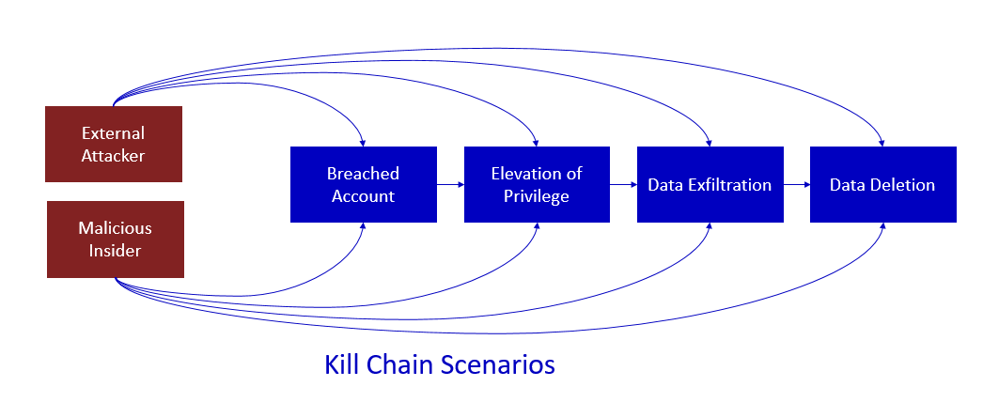
Explore today's work and threat landscape
Most attacks follow a common process referred to as the “Kill Chain”
An attack follows a basic pattern and proceeds from one step to the next
This step-wise process can be defended against by implementing security measures on choke points in the chain
How much control do companies have?
While data is being shared with employees, business partners, and customers, organizations must protect users’ identities and data stored on their devices and apps
In today’s cloud-centric world, data is now stored everywhere - it’s on-premises, on PCs, on phones, and in the cloud – making it more difficult than ever to protect
As hackers become more sophisticated in their attacks, data theft continues to rise

Slide 6
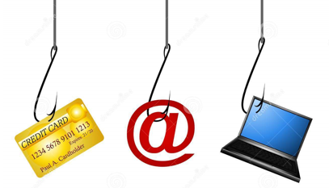
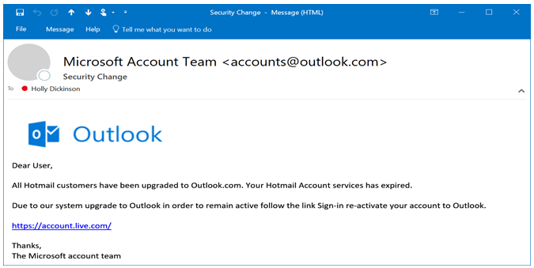
Examine how phishing retrieves sensitive information
Phishing is a technique a hacker uses to retrieve sensitive information, such as a user’s account credentials or credit card number
Phishing attempts try to entice users to click a link to a malicious website that looks legitimate except for the URL of the website in question
Spear phishing is a type of phishing attack directed at specific individuals
Phishing emails usually contain branding and URLs that, on the surface, appear legitimate

Slide 7
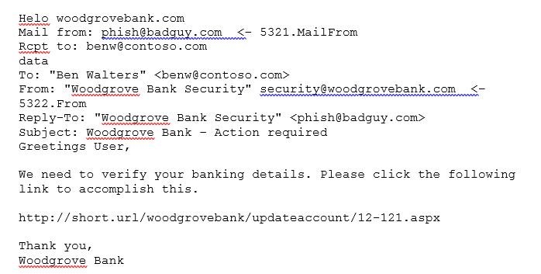
Examine how spoofing deceives users and compromises data security
Spoofing is a technique used to forge an email header so that the message appears to recipients as having been sent from a trusted source
Spoofing is also used by attackers to trick the recipient into divulging information such as account credentials, credit card information, or other sensitive information
An email message contains two sender addresses:
5321.MailFrom – Used by a sending mail server to identify the sender, shown in the header as “Mail from”. This is the address of the actual sender (see phish@badguy.com).
5322.From – The address displayed as the From address by the mail client, shown in the header as “From”. This is who the recipient thinks sent the message (see “Woodgrove Bank Security” security@woodgrovebank.com)
When the recipient receives this message, they'll only see that it’s from "Woodgrove Bank Security“ (security@woodgrovebank.com).
They won't realize that it was sent from phish@badguy.com.

Slide 8
Compare spam and malware
Spam and bulk email usually don’t carry a payload that causes harm to a user’s system
Malware, on the other hand, can cause great harm to an organization
Malware is often received in email as either an attachment or an embedded link to a malicious web site or file
Malware typically works in two stages:
Stage 1 is when you open an infected attachment or visit a malicious web site
Stage 2 is delivering the malicious payload

Slide 9

Examine how an account breach compromises a user account
An account breach occurs when a user’s account is compromised so that it can be used by an attacker to access network resources
One of the recommended methods that can be used to mitigate an account breach is to use Multifactor Authentication (MFA)
You can protect against password cracking attempts by enabling directory controls against multiple failed logon attempts, such as disabling the account after three failed attempts

Slide 10

Examine elevation of privilege attacks
In an elevation of privilege scenario, an attacker has compromised one or more accounts and is now working to increase their power
If administrators share the same machine and the machine gets compromised, it then becomes easy for the attacker to figure out how to log on to the shared machine and run a credential harvesting tool
It’s recommended that you use multifactor authentication, especially with admin accounts or accounts with access to sensitive content
It’s also recommended to have a small number of global administrators

Slide 11

Examine how data exfiltration moves data out of your tenant
Data exfiltration is the unauthorized retrieval of data from a computer or service
Protecting your service from account breaches and elevation of privilege will be the first step in protecting your data
To prevent data exfiltration, you should consider:
Access Control Lists
External Sharing Policies
Least Privilege
Data Classification Schemes
Data Loss Prevention (DLP)

Slide 12

Examine how attackers delete data from your tenant
Data deletion occurs when an attacker deletes your data, usually in a way that makes recovery difficult
A variant of this type of attack includes ransomware, where an attacker:
Compromises the network
Encrypts data
Demands payment to get the key to decrypt the data
To prevent account breach and elevation of privilege:
Employ data protection mechanisms
Ensure that you have sufficient redundancies

Slide 13
Examine how data spillage exposes data outside your tenant
Data spillage occurs when protected data is transferred to a system that doesn’t provide the same level of protection as the source
One of the most effective methods for preventing the unexpected or malicious exposure of data outside your tenant includes implementing a solution such as Azure Information Protection
Documents that contain regular expressions like credit cards and social security numbers can be protected by implementing Data Loss Prevention (DLP) policies

Slide 14
Examine other types of attacks
Password cracking:
An attacker has acquired access to an application, service, or data store that allows them to try many different password combinations for an account
To prevent password cracking use smart password lockout
Malicious insider:
One of your approved users is performing illicit activities in your tenant
To prevent this, you must ensure that your accounts are secure, your privileges are well managed, and that your data is well protected

Slide 15

Knowledge Check
Test your knowledge of this module by reviewing the Knowledge Check questions in your student manual

Slide 16
Summary
This module examined the following threat vectors and data breaches:
Techniques used by hackers to compromise user accounts through email:
Phishing
Spoofing
Malware
Techniques used by hackers to gain control over resources:
Account breaches
Elevation of privilege
Password cracking
Techniques used by hackers to compromise data:
Data exfiltration
Data deletion
Data spillage

Slide 17
Module 2: Explore the Zero Trust security model

Slide 18
Introduction
This module examines the concepts and principles of the Zero Trust model and how Microsoft 365 supports it
Organizations need a security model that:
Effectively adapts to the complexity of the modern environment
Embraces the mobile workforce
Protects people, devices, apps, and data wherever they are located
The security model to support this modern reality is called Zero Trust

Slide 19
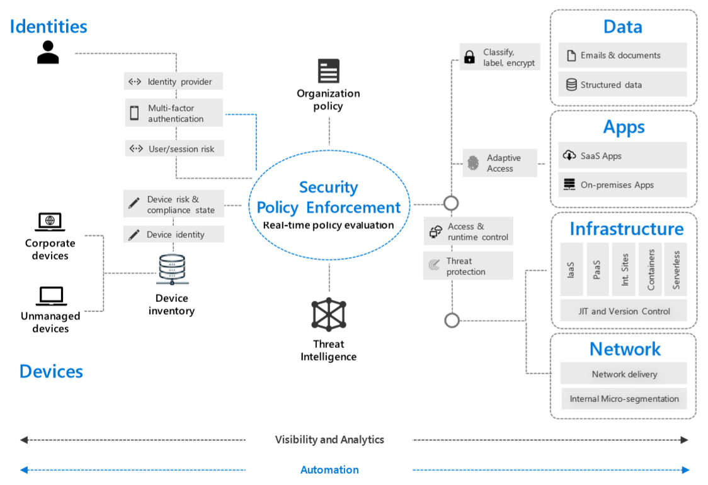
Examine the principles and components of the Zero Trust model
The basic premise of the Zero Trust model assumes that every request is a potential breach; as such, every request must be verified as though it originates from an open network
“Never trust, always verify”
Principles of the Zero Trust model:
Verify explicitly
Use least privileged access
Assume breach
Components of the Zero Trust model:
Identities
Devices
Applications
Data
Infrastructure
Network

Slide 20
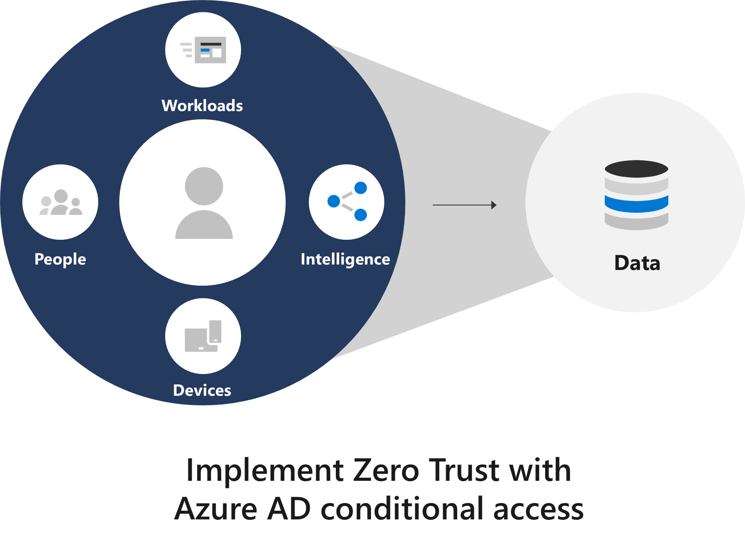
Plan for a Zero Trust security model in your organization
The five steps to securing your identity infrastructure include:
Strengthen your credentials
Reduce your attack surface area
Automate threat response
Increase your awareness
Enable user self-help
Azure Active Directory (Azure AD) provides the strong, adaptive, standards-based identity verification required in a Zero Trust framework
Assess where you are on your Zero Trust journey by running the Zero Trust Assessment tool

Slide 21
Examine Microsoft's strategy for Zero Trust networking
Azure AD conditional access is the foundational building block of how customers can implement a Zero Trust network approach
Conditional access and Azure AD Identity Protection make dynamic access control decisions based on user, device, location, and session risk for every resource request. They combine:
Attested runtime signals about the security state of a Windows device
The trustworthiness of the user session and identity to arrive at the strongest possible security posture
Conditional access provides a set of policies that can be configured to control the circumstances in which users can access corporate resources. Considerations for access include:
User role Mobile applications
Group membership Location
Device health and compliance Sign-in Risk
See the Zero Trust networking model in Microsoft 365 on the next slide

Slide 22
Examine Microsoft's strategy for Zero Trust networking(continued)
To accomplish the Zero Trust model, Microsoft integrates several components and capabilities in Microsoft 365, including:
Windows Defender Advanced Threat Protection
Azure Active Directory
Windows Defender System Guard
Microsoft Intune
Machine risk level
isCompliant
Azure AD
Windows Defender ATP
Microsoft Intune
Windows Defender System guard
Device health signals^{1,2}
Device compliance signals³
Device attestation
Windows 10 device
¹Boot time:
Code integrity
Secure Boot
DRTM/DMA
²Runtime:
Vulnerability assessment
Antivirus
Runtime assertions
Hardware profile
Security configuration
³Mobile Device Management

Slide 23
Knowledge Check
Test your knowledge of this module by reviewing the Knowledge Check questions in your student manual

Slide 24
Summary
This module examined the following items related to the Zero Trust approach to security in Microsoft 365:
The principles and components of the Zero Trust security model
The five steps to implementing a Zero Trust security model
Microsoft's story and strategy around Zero Trust networking

Slide 25
Module 3: Explore security solutions in Microsoft 365 Defender

Slide 26
Introduction
This module examines the following Microsoft 365 security solutions that can help protect an organization’s users, resources and data:
Microsoft Defender for Office 365
Microsoft Defender for Identity
Microsoft Defender for Endpoint
Microsoft 365 Threat Intelligence
Microsoft Cloud App Security

Slide 27
Enhance your email security using Exchange Online Protection and Microsoft Defender for Office 365
Microsoft 365 services provide email protection against spoofing and phishing attacks, spam, and malware with Exchange Online Protection (EOP) and Microsoft Defender for Office 365
EOP uses a combination of IP and URL reputation, domain reputation, spam and malware filtering, content filtering, and connection filtering
EOP can be extended to include more advanced features by enabling Microsoft Defender for Office 365 (formerly Office 365 Advanced Threat Protection) in the tenant
Microsoft Defender for Office 365 is a collection of features designed to combat advanced targeted threats. It includes:
Safe Attachments Quarantine Spoof Intelligence
Safe Links Anti-phishing
The next slide shows a diagram of EOP and Microsoft Defender for Office 365 protection

Slide 28
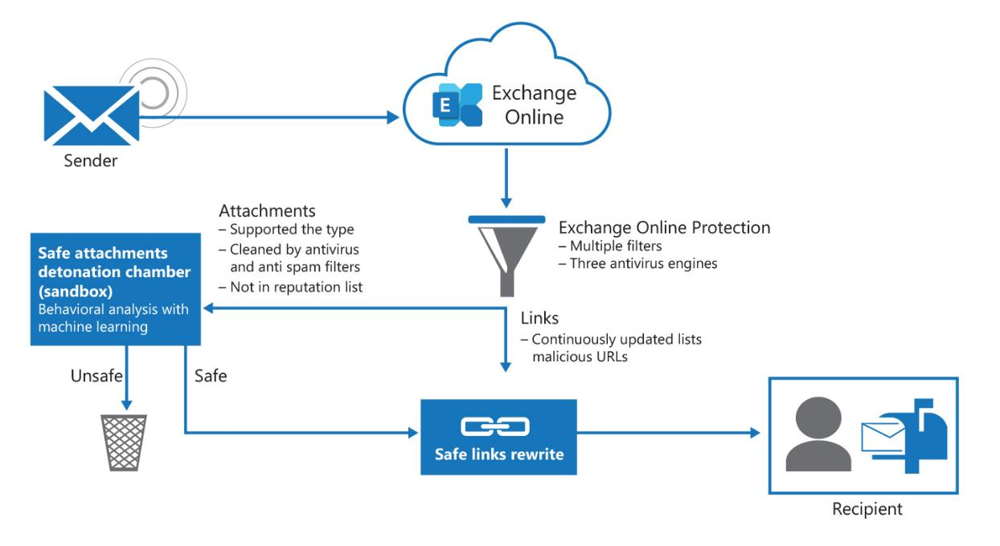
Enhance your email security using Exchange Online Protection and Microsoft Defender for Office 365 (continued)
Diagram showing EOP and the primary Microsoft Defender for Office 365 features
against incoming threats through email

Slide 29
Protect your organization's identities using Microsoft Defender for Identity
Microsoft Defender for Identity enables security operation analysts and security professionals struggling to detect advanced attacks in hybrid environments to:
Monitor and profile user behavior and activities
Protect user identities and reduce the attack surface
Identify suspicious activities and advanced attacks across the cyber-attack kill-chain
Investigate alerts and user activities

Slide 30
Protect your enterprise network against advanced threats using Microsoft Defender for Endpoint
Microsoft Defender for Endpoint uses a combination of the following technology built into Windows 10/11 and Microsoft's robust cloud service:
Endpoint behavioral sensors
Cloud security analytic
Threat intelligence
Microsoft Defender for Endpoint integrates the following features to deliver preventative protection, post-breach detection, automated investigation, and response:
Threat and vulnerability management
Attack surface reduction
Microsoft Defender Antivirus
Endpoint detection and response
Automated investigation and remediation
Microsoft Secure Score for Devices
Microsoft Threat Experts

Slide 31
Protect against cyber attacks using Microsoft 365 Threat Intelligence
Microsoft 365 Threat Intelligence is a cloud-based service that:
Provides organizations broad visibility into the threat landscape
Delivers actionable insights and enables proactive cyber-defense
Organizations use Microsoft 365 Threat Intelligence to:
Make data driven decisions on their cybersecurity requirements
Gain insight into:
How threats are manifested
Who is being threatened
Types of threats
Frequency of those threats
Microsoft 365 Threat Intelligence includes Threat Explorer
Threat Explorer provides security analysts with reports and graphical views of the threat landscape in their tenant for actionable insights and recommendations on policy and enforcement

Slide 32
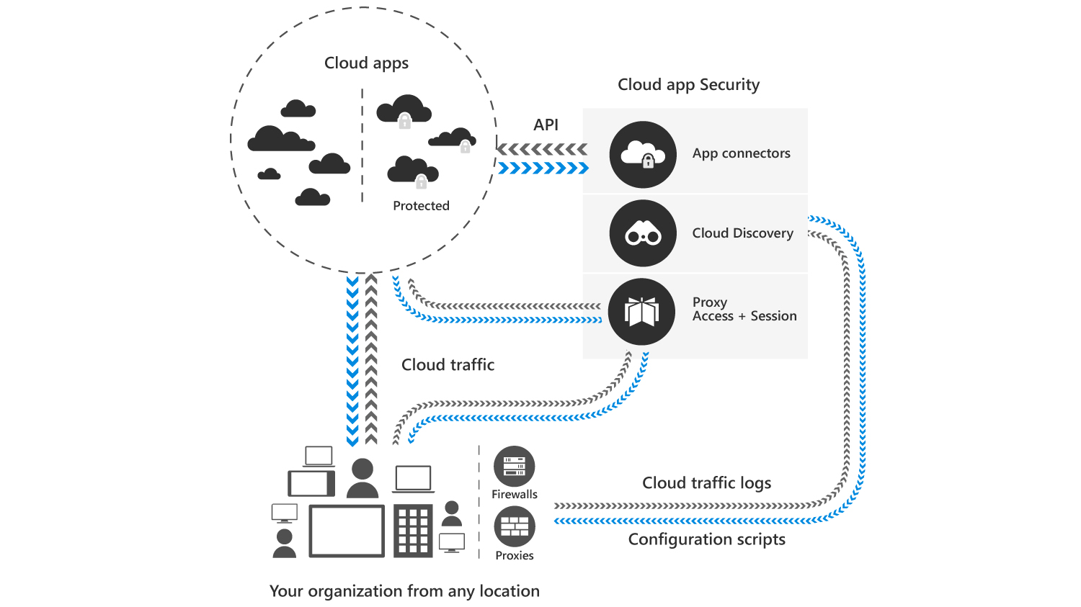
Provide insight into suspicious activity using Microsoft Cloud App Security
Cloud App Security is a critical component of the Microsoft Cloud Security stack:
It provides insight into suspicious activity in Microsoft 365 by giving you enhanced visibility and control over your Microsoft 365 tenant
Cloud App Security allows an organization to safely move to the cloud while maintaining control of critical data by:
Helping uncover shadow IT
Assessing risk
Enforcing policies
Investigating activities
Stopping threats
Cloud App Security includes:
Threat detection
Enhanced control
Discovery and insights

Slide 33
Review the security reports in Microsoft 365 Defender
The Microsoft 365 Defender portal includes three types of reports:
Security reports. Track the protection status of an organization's identities, data, devices, apps, and infrastructure.
Email and collaboration reports. Enable organizations to review Microsoft recommended actions to help improve email and collaboration security.
Endpoints reports. Enable organizations to view information concerning threat protection, device health and compliance, vulnerable devices, and Web protection.
A user must be a member of one of the following role groups in the Microsoft 365 Defender portal to access these reports:
Organization Management
Security Administrator
Security Reader
Global Reader

Slide 34
Knowledge Check
Test your knowledge of this module by reviewing the Knowledge Check questions in your student manual

Slide 35
Summary
This module examined the following Microsoft 365 security solutions:
Microsoft Defender for Office 365 - enhances email security in a Microsoft 365 deployment
Microsoft Defender for Identity - identifies, detects, and investigates advanced threats, compromised identities, and malicious insider actions directed at an organization
Microsoft Defender for Endpoint - helps enterprise networks prevent, detect, investigate, and respond to advanced threats
Microsoft 365 Threat Intelligence – provides broad visibility into an organization’s threat landscape and actionable insights that enable a proactive cyber defense
Microsoft Cloud App Security - enhances visibility and control over a Microsoft 365 tenant

Slide 36
Module 4: Examine Microsoft Secure Score

Slide 37
Introduction
Microsoft Secure Score is a security analytics tool designed to help organizations understand:
- What they’ve done to reduce the risk to their data
- What they can do to further reduce that risk
This module examines:
Benefits of using Microsoft Secure Score
The information displayed on the Microsoft Secure Score dashboard
Using the Secure Score API to integrate Secure Score data into Microsoft Graph
Using Secure Score to improve your security posture and identify security risks

Slide 38
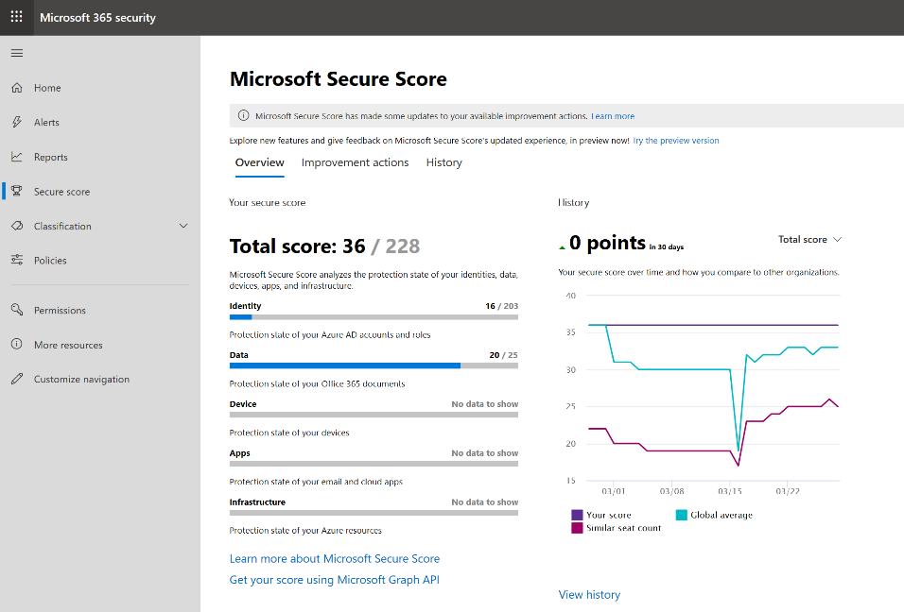
Explore Microsoft Secure Score
Microsoft Secure Score provides a numerical rating of an organization’s security posture within Microsoft 365
You’re given points for:
Configuring recommended security features
Performing security-related tasks
Addressing the improvement action with a third-party application or software
Secure Score helps organizations:
Report on the current state of their security posture
Improve their security posture by providing discoverability, visibility, guidance, and control
Compare with benchmarks and establish key performance indicators (KPIs)
Identify the extent to which they have adopted security controls in their Microsoft environment that can help offset the risk of being breached

Slide 39
Examine the Secure Score Dashboard
Global administrators can access Microsoft Secure Score tool, which displays the Secure Score Dashboard
The dashboard provides a quick view into an organization’s security posture through the following tabs:
Overview. Displays improvement actions that are organized into the following groups:
Identity App Device
Data Infrastructure
Improvement actions. Lists the security recommendations that address possible attack surfaces, along with their status (completed, not completed, resolved through third party, and ignored)
Ranking. Based on the number of remaining points left to achieve, implementation difficulty, user impact, and complexity
Actions. Tracks the status of improvement actions recommended by Microsoft Secure Score
History. Displays a graph of your organization's score over time

Slide 40
Collect Secure Score data using the Secure Score API
In addition to the web-based Secure Score tool, there is also a Secure Score API which is fully integrated into Microsoft Graph
Potential benefits of collecting Secure Score data through Microsoft Graph include the following scenarios:
Monitor and report on your Secure Score in downstream reporting tools
Track your security configuration baseline
Integrate the data into compliance or cybersecurity insurance applications
Integrate Secure Score data into your Security Incident and Event Management (SIEM) or Cloud Access Security Broker (CASB) solutions to drive a hybrid or multi-cloud framework for security analytics
Once the Secure Score API has been set up, PowerShell scripts are used to retrieve the necessary data from Secure Score:
Using the Get-Secure Score API cmdlet, you can feed data into a Power BI dashboard, conduct advanced analytics, and quickly generate a historical view of the last 30 days of secure score data

Slide 41
Collect Secure Score data using the Secure Score API (continued)
Acquiring the secure score data from the API in a secure way requires you to set up a few pre-requisites:
Choose your consumption model
Register your application in Azure Active Directory so that you can call the Secure Score API
Grant your application consent to pull data from the Secure Score API
Pull the data

Slide 42
Improve your security posture
Once you have used the Secure Score tool to determine the current state of your organization’s security, the next step is to analyze your findings and plan how to improve conditions
During this planning process, you should consider:
Potential for risk
Difficulty of implementing proposed solutions
Time frames for implementation
Impact to your rating based on each Microsoft 365 Secure Score action
Every organization is going to have different success criteria
When designing a security upgrade plan, a common approach is to begin by implementing actions that have the lowest impact on user productivity while providing immediate gains, such as:
Enabling multi-factor authentication on all admin accounts
Designating more than one Global Admin
Enabling auditing across workloads
Enabling mailbox auditing
Having a weekly review of sign-ins:
After multiple failures
From unknown sources
From multiple geographies

Slide 43
Knowledge Check
Test your knowledge of this module by reviewing the Knowledge Check questions in your student manual

Slide 44
Summary
This module examined the following items related to Microsoft Secure Score:
The benefits of Secure Score and what kind of services can be analyzed
How to collect data using the Secure Score API
How to use the tool to identify gaps between your current state and where you would like to be regarding security
Identify actions that will increase your security by mitigating risks
Determine the threats each action will mitigate and the impact it has on users

Slide 45
Lab 1 – Tenant Setup and Privileged Identity Management

Slide 46
Lab exercises
Lab Introduction
Important: Read through the introduction that appears in the lab instructions before you start this lab
Exercise 1: Initialize your Microsoft 365 Tenant
Task 1
Obtain your Microsoft 365 credentials
Task 2
Set Up the Organizational Profile
Task 3
Create a Microsoft 365 Global Admin account
Task 4
Set up Microsoft 365 User Accounts and Groups
Task 5
Enable IRM for SharePoint Online
Task 6
Turn on Audit Logging to enable Alert Policies
Task 7
Prepare Users for Content Searches

Slide 47
Module 5: Examine Privileged Identity Management

Slide 48

Introduction
Privileged Identity Management (PIM) is an Azure AD service that enables an organization to manage, control, and monitor access to important resources, such as Azure AD, Azure, Microsoft 365, and Microsoft Intune
PIM enables organizations to minimize the number of people who have access to secure information or resources
This module examines the following PIM features:
Configure PIM for use in your organization
Audit PIM roles
Microsoft Identity Manager
Privileged Access Management

Slide 49
Explore Privileged Identity Management in Azure AD
Azure AD Privileged Identity Management (PIM) enables you to manage, control, and monitor access within your organization
Azure AD Privileged Identity Management helps your organization:
Review which users are assigned privileged roles to manage Azure resources, as well as which users are assigned administrative roles in Azure AD
Enable on-demand, “just in time” administrative access to Microsoft Online Services
See a history of administrator activation, including changes made
Receive alerts about changes in administrator assignments
Require approval to activate Azure AD privileged admin roles
Review membership of administrative roles
Notes:
Supporting videos for instructor or student use:
Azure Active Directory: Identity Management and Protection
https://youtu.be/9LGIJ2-FKIM

Slide 50
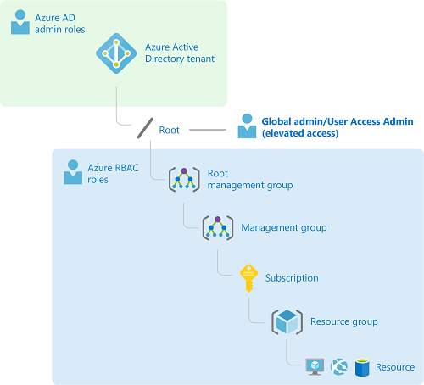
Configure Privileged Identity Management
PIM enables an organization to:
Detect potential vulnerabilities affecting its users’ identities
Configure automated responses to detected suspicious actions that are related to its users’ identities
Investigate suspicious incidents and take appropriate action to resolve them
Notes:
Supporting videos for instructor or student use:
Azure Active Directory Identity Protection
https://youtu.be/zI3jn_G0_Ns

Slide 51
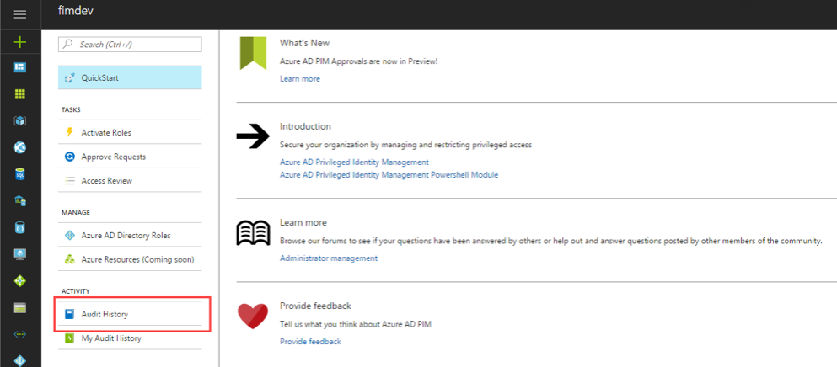
Audit Privileged Identity Management
You can use the Privileged Identity Management (PIM) audit history to see all the user assignments and activations within a given time period for all privileged roles

Slide 52
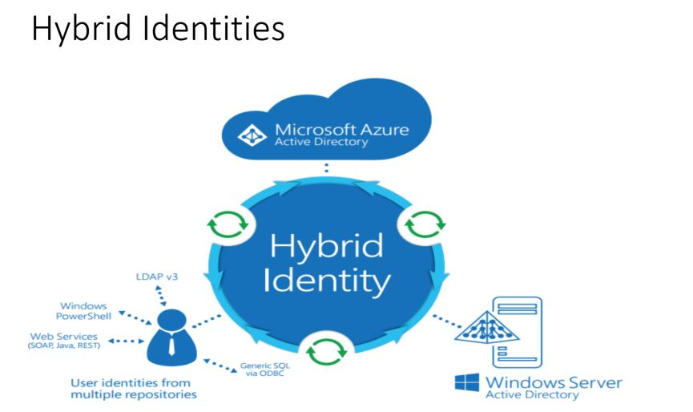
Explore Microsoft Identity Management
Microsoft Identity Manager (MIM) helps organizations manage the users, credentials, policies, andaccess within their organizations and hybrid environments
Hybrid Identities

Slide 53
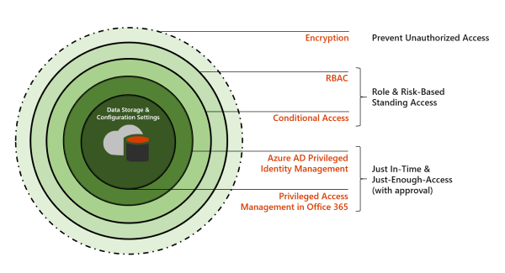
Control privileged admin tasks using Privileged Access Management
Azure AD Privileged Identity Management (PIM) primarily allows managing access to AD roles and role groups. Conversely, Privileged Access Management (PAM) in Microsoft 365 is only applied at the task level
Notes:
Supporting videos for instructor or student use:
Introducing Privileged Access Management in Office 365
https://youtu.be/Mya2vkW_IcU

Slide 54
Knowledge Check
Test your knowledge of this module by reviewing the Knowledge Check questions in your student manual

Slide 55
Summary
This module examined the following items related to Privileged Identity Management in Azure AD:
Configure PIM for use in your organization
Audit PIM roles
Microsoft Identity Manager
Privileged Access Management in Microsoft 365

Slide 56
Module 6: Examine Azure Identity Protection

Slide 57
Introduction
With Azure Identity Protection, organizations can use the same protection systems Microsoft uses to secure identities
Most security breaches take place when attackers gain access to an environment by stealing a user’s identity
Azure Active Directory uses adaptive machine learning algorithms and heuristics to detect anomalies and suspicious incidents that indicate potentially compromised identities
Using this data, Azure Identity Protection generates reports and alerts that enable organizations to evaluate the detected issues and take appropriate mitigation or remediation actions
This module examines the key features of Azure Identity Protection

Slide 58
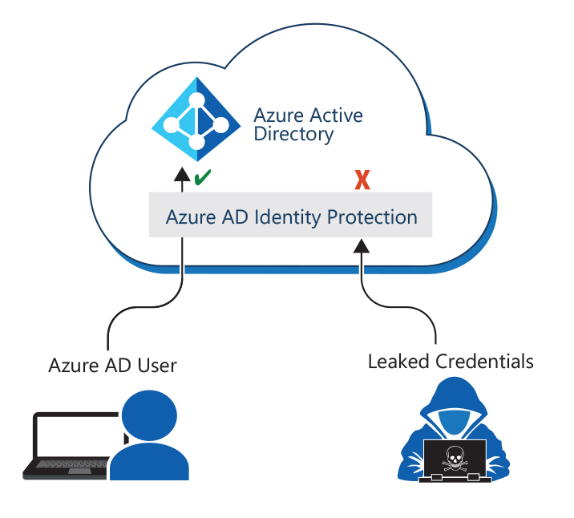
Explore Azure Identity Protection
Azure Identity Protection (AIP) is a cloud-based solution that:
Helps an organization monitor and report compromised or abused identities within its environment by:
Calculating a real-time sign-in risk each time a user authenticates
Determining an overall risk level for reach user
Enables an organization to automatically act on these risk detections by configuring user-risk policies and sign-in risk policies
Azure Identity Protection is a technology inside Azure Active Directory that recognizes malicious activity and calculates risks based on the user activity
Azure Identity Protection provides organizations with capabilities for:
Detecting vulnerabilities and risky accounts
Investigating risk events
Building risk-based conditional access policies

Slide 59
Enable the default protection policies in AIP
Azure Identity Protection includes three policies that organizations can enable:
User risk policy
Calculates the probability that an identity has been compromised
Sign-in risk policy
Analyzes signals from each sign-in and calculates a risk score based on the probability that the sign-in was not performed by the user
MFA registration policy
Ensures new users register for Multi-Factor Authentication on their first day

Slide 60
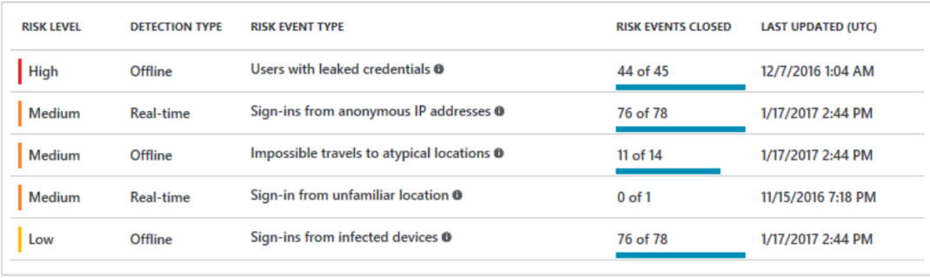
Explore the vulnerabilities and risk events detected by AIP
Vulnerabilities reported by Azure Identity Protection, along with recommendations on how to address those issues, include:
Multifactor authentication registration not configured
Sign-ins from anonymous IP address
Unmanaged cloud apps
Impossible travel to atypical locations
Security Alerts from Privileged Identity Management
Sign-in from unfamiliar locations
Azure Active Directory risk events
Sign-ins from infected devices
Users with Leaked credentials
Sign-ins from IP addresses with suspicious activity

Slide 61
Plan your identity investigation
You should use the Identity Protection dashboard to plan investigations of incidents
The dashboard provides access to:
Reports such as Users flagged for risk, Risk events, and Vulnerabilities
Security Settings, including Security Policies, Notifications, and Multifactor Authentication registration
Mitigation best practices include:
Exclude users who do not/cannot have multifactor authentication
Exclude users in locales where enabling the policy is not practical, such as locales with no access to a help desk
Exclude users who are likely to generate a lot of false-positives
Use a High threshold during initial policy roll out, or if you must minimize challenges seen by end-users
Use a Low threshold if your organization requires greater security

Slide 62
Knowledge Check
Test your knowledge of this module by reviewing the Knowledge Check questions in your student manual

Slide 63
Summary
This module examined the following items related to Azure Identity Protection:
The kind of identities that can be protected
How to enable Azure Identity Protection
How to identify vulnerabilities and risk events
Plan your investigation in protecting cloud-based identities and how to protect your Azure Active Directory environment from security breaches

Slide 64
Lab 1 – Tenant Setup and Privileged Identity Management (Continued)

Slide 65
Lab exercises (Continued)
Exercise 2: PIM Administrator approval
Task 1
Configure the Global Admin role to require approval
Task 2
Assign an eligible group to the Global Admin role
Task 3
Submit a request for the Global Admin role
Task 4
Approve the request for the Global Admin role

Slide 66
Lab exercises (Continued)
Exercise 3: PIM Self-approval
Task 1
Create an eligible group for the Helpdesk Admin role
Task 2
Configure the Helpdesk Admin role for self-approval
Task 3
Self-activate the Helpdesk Admin role
Task 4
Verify a PIM notification was issued

Slide 67
Lab exercises (Continued)
Exercise 4: PIM Teammate approval
Task 1
Create a group for the Intune Admin role
Task 2
Configure the Intune Admin role to require approval
Task 3
Submit a request for the Intune Admin role
Task 4
Approve the request for the Intune Admin role
Task 5
Verify a PIM notification was issued

Slide 68
Module 7: Learning Path Review

Slide 69
Discussion – Learning Path review
What are your key takeaways from this learning path, and why?
What are the key features discussed in this learning path that you foresee implementing at your organization?

Slide 70
Closing Slide

